Slide 1

Java Method String
Universitas Nusa Putra

Slide 2
String explanation
String is a data type for storing values in the form of text.
String is a class (reference data type).
When variable of type String is created, Java compiler will automatically create a String object. In the JDK, the String class is stored in java.lang package.

Slide 3
String v Char String can store more than one character (text).
Char can only store one character.
String is a reference data type.
Char is a primitive data type.
To initialize, use the “ (double-quote) sign.
Initialize char using the ‘ (single-quote) sign.

Slide 4
String Methods In Java
Java String Length()
Java String Substring()
Java String chartAt()
Java String toLowerCase()
Java String toUpper()
Java String replace()
Java String contains()
Java String equals()
Java String equalsIgnoreCase()
Java String endsWith()

Slide 5
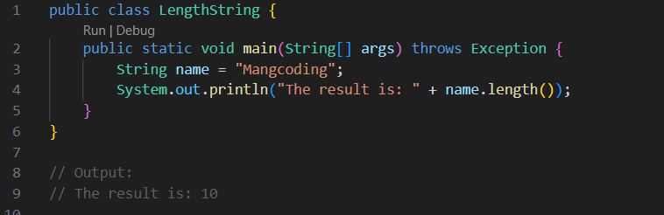
Java String length()
This method is used to count the number of characters, in the data/ values from variables that use the String data type, because method length() method is used to count or return the number of characters. The data from the method has a numeric value. So you can store it in an Integer type variable.

Slide 6
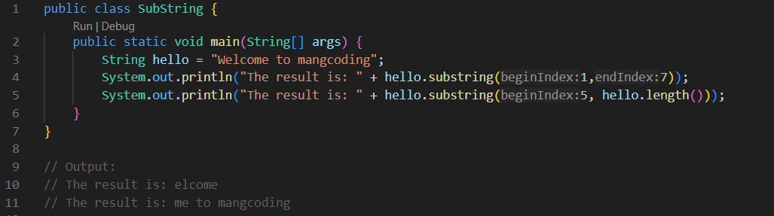
Java String substring()
Substring is a function used to extract several characters from a sentence or word. This function has 2 parameters, namely the starting index and also the ending index. The index is taken according to the sequence of characters in the sentence. (The first character has index 0)

Slide 7
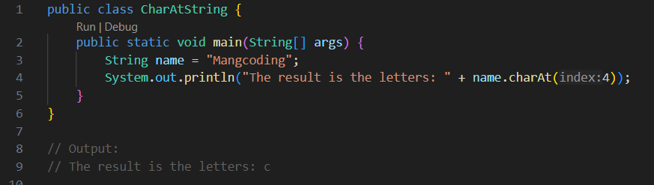
Java String chartAt()
The charAt method is used to retrieve characters in a String according to the desired index.

Slide 8
Java String toLowerCase()
The toLowerCase() method functions to convert characters in a string to lowercase. If there are uppercase letters, they will be changed to lowercase.
So what if it’s lowercase?
If the letters are lowercase, of course they will kept in lowercase form. Because that is the function of the function of the toLowerCase() method.

Slide 9
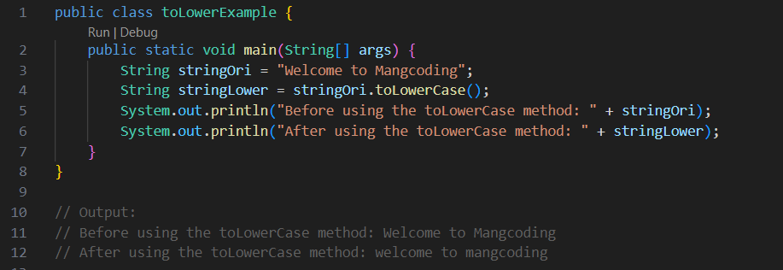
Java String toLowerCase()

Slide 10
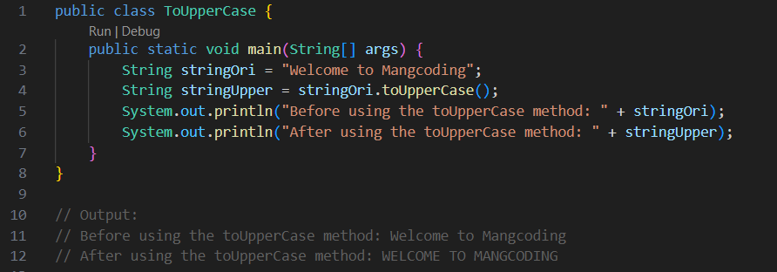
Java String toUpper()
If previously we converted to lowercase. A method toUpperCase() is the opposite, this method changes to uppercase.

Slide 11
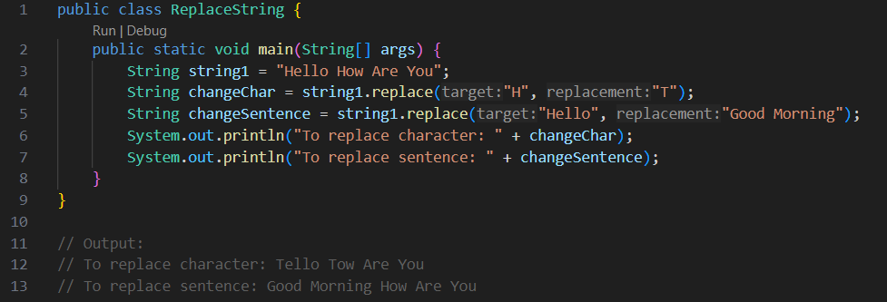
Java String replace()
The replace() method has two functions. The first function is to replace an original character with the desired character. The second function is to replace the source string with the destination string.

Slide 12
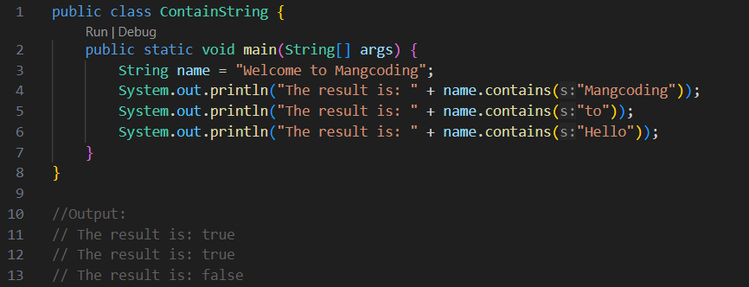
Java String contains()
The contains() method functions to find whether the contents of the string we are looking for are not contained in a string. The results returned are True and False.

Slide 13
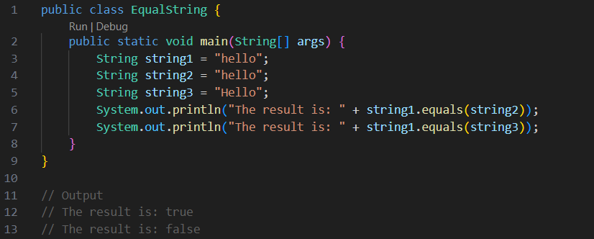
Java String equals()
The function of the equals() method is similar to the contains() method, namely that it will search for a string, if it is found it will be True, and if it is not found it will False. What you need to pay attention to when using this method is that uppercase and lowercase letters must be distinguished.

Slide 14
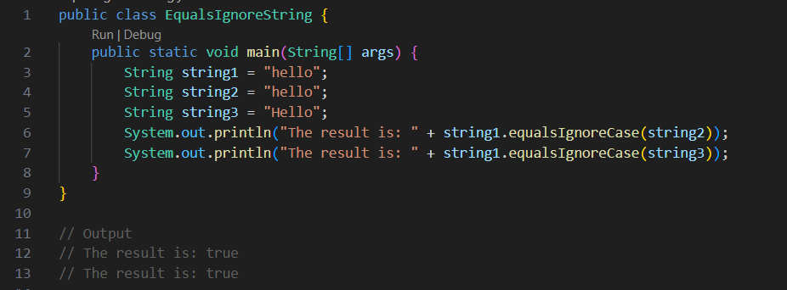
Java String equalsIgnoreCase()
If the equals() method in searching for a string differentiates uppercase and lowercase letters (Case Sensitive), then the equalsIgnoreCase() method is the opposite. Of course, this method only focuses on searching for characters in a string without caring about upper or lower case.

Slide 15
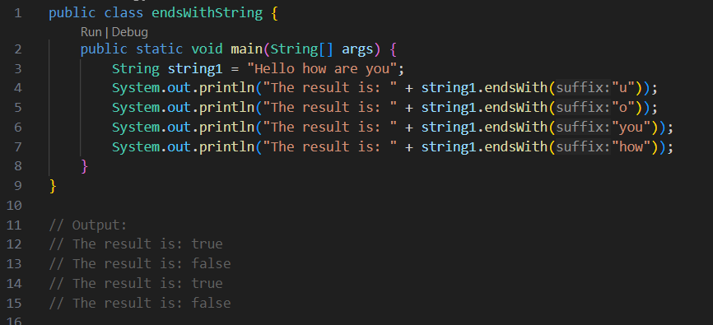
Java String endsWith()
The endsWith() method has a function to check whether the ending we want to look for is in the string or not. The ending sought can be a character or a sentence. The returned values are True and False.

